Slide 1

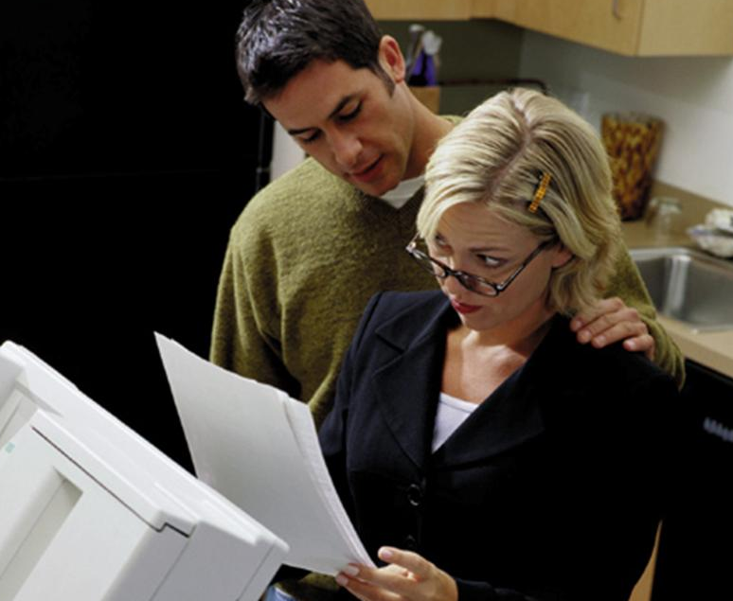
Sexual Harassment
What Employees Need to Know

Slide 2
SESSION OBJECTIVES
You will be able to:
Recognize sexual harassment
Differentiate between the two main kinds of harassment
Understand and follow company policy
Report incidents and cooperate in investigations
Help promote and maintain a comfortable, productive work environment
Notes:
Slide Show Notes
The main objective of this training session is to inform you about sexual harassment so that your awareness of this issue will help prevent it. By the end of this session you will be able to:
Recognize sexual harassment
Differentiate between the two main kinds of harassment
Understand and follow company policy regarding sexual harassment
Report incidents and cooperate in investigations of sexual harassment; and
Help promote and maintain a comfortable, productive work environment
At the end of this session, you’ll take a short quiz to test your understanding.

Slide 3
SESSION OUTLINE
Why it’s important for you to know about sexual harassment
Laws that prohibit sexual harassment in the workplace
What constitutes sexual harassment
Who is affected by it
What to do about it
How to prevent it
Notes:
Slide Show Notes
This session will discuss:
Why it’s important for you to know about sexual harassment;
The laws that prohibit sexual harassment in the workplace;
What constitutes sexual harassment;
Who is affected by sexual harassment;
What to do about it; and
How to prevent sexual harassment
Feel free to ask questions during the presentation if anything is unclear or needs further explanation.

Slide 4
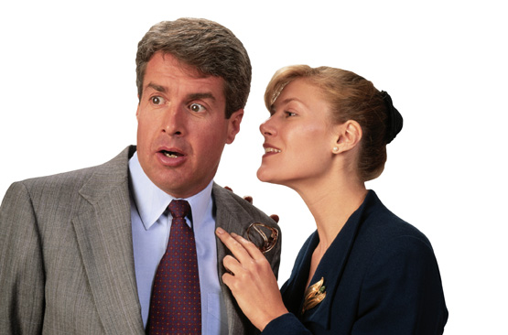
WHY YOU NEED TO KNOW
We all have the right to fair treatment at work
Sexual harassment harms everyone
It undermines the trust and respect necessary for a productive work environment
Men and women on every level may be harassers or victims
Notes:
Slide Show Notes
Why do you need to know about sexual harassment? First of all, we want you to work in an environment that is free of sexual harassment. If you and your colleagues understand what it is and why it is harmful, this will help prevent it. In addition, you need to know about this subject because:
We all have the right to fair treatment at work;
Sexual harassment harms everyone, not just the victim;
It undermines the trust and respect necessary for a productive work environment; and
Sexual harassment is not just a woman’s issue—men and women on every level may be either harassers or victims.

Slide 5
HOW WIDESPREAD IS SEXUAL HARASSMENT
About 70% of women and 20% of men have experienced sexual harassment
About 15,000 sexual harassment cases are filed each year
Charges of sexual harassment cost U.S. companies almost $40 million each year
Complaints filed by men have more than tripled in recent years
Notes:
Slide Show Notes
Just how widespread is the problem of sexual harassment? Consider these statistics:
About 70% of women and 20% of men have experienced sexual harassment in the workplace.
There are about 15,000 cases of sexual harassment filed each year in the United States.
These charges cost U.S. companies almost $40 million each year.
The number of complaints filed by men has more than tripled in recent years, indicating this is not just a woman’s problem.

Slide 6

HARASSMENT AND THE LAW
Title VII
The courts
State law
Equal Employment Opportunity Commission (EEOC)
Notes:
Slide Show Notes
Let’s consider what the law says about sexual harassment.
Title VII of the Civil Rights Act generally prohibits employers from discrimination in employment based on race, color, national origin, religion, or sex;
Courts have interpreted sexual harassment as a form of sex discrimination that is prohibited by Title VII;
State civil rights and fair employment laws also prohibit sexual harassment in the workplace; and
Finally, the U.S. Equal Employment Opportunity Commission (EEOC) has issued a comprehensive definition of sexual harassment, which we’ll discuss further on the next slide.

Slide 7
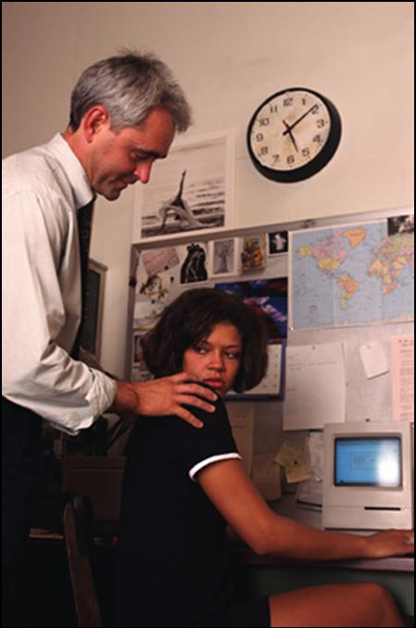
HARASSMENT AND THE LAW (cont.)
EEOC defines sexual harassment as sexual conduct that is:
Unwelcome
Harmful
Illegal
Notes:
Slide Show Notes
The EEOC defines sexual harassment as sexual conduct that is unwelcome, harmful, or illegal.
Unwelcome conduct can include sexual advances, requests for sexual favors, verbal or physical conduct of a sexual nature, or displays of sexually explicit or suggestive materials.
Harmful conduct can harm either the physical or emotional health of the victim, or of witnesses to the conduct. This can also negatively affect the atmosphere of the workplace in general.
Finally, remember that all forms of sexual harassment are illegal, and cannot be tolerated.

Slide 8

IS THIS SEXUAL HARASSMENT?
A female employee wears miniskirts
A female supervisor makes frequent comments about a male employee’s physique
A male supervisor makes frequent comments about a male employee’s physique
Notes:
Slide Show Notes
A little later in the session, we’ll get into a more specific definition of sexual harassment. But first let’s take a moment now to play judge and decide whether these actions are harassment.
Let’s take a look at this example: A female employee wears miniskirts to work. Is this inviting sexual harassment?
No. Employees must abide by the workplace’s dress code, but if the code permits miniskirts, employees have the right to wear them without being harassed.
Let’s take a look at this example: A female supervisor makes frequent comments about a male employee’s physique. Is this sexual harassment?
Yes. Male employees can be victims of sexual harassment and have the same protection under the law as female employees.
Here’s a third example: A male supervisor makes frequent comments about a male employee’s physique. Is this sexual harassment?
Yes. Sexual harassment can happen between two people of the same gender. The key point is not the sexual orientation of the people involved but that the harassment is sexual in nature.

Slide 9

IS THIS SEXUAL HARASSMENT? (cont.)
Two co-workers forward each other off-color jokes they receive in e-mails
An employee asks a co-worker out
Two co-workers develop a personal relationship
Notes:
Slide Show Notes
Here are some other scenarios.
Two employees forward each other off-color jokes that they receive in e-mails. Is this sexual harassment?
No. This exchange is not unwelcome; however, it may violate the e-mail policy at your workplace. If one of the employees suddenly complains of sexual harassment, the claim probably won’t stand because the employee had been participating in the behavior and had not indicated it was offensive. If one of the employees decides that the exchange is no longer welcome, he or she needs to communicate this to the other employee – and the other employee needs to stop sending jokes.
What about this example: An employee asks a co-worker out on a date. Is this sexual harassment?
No, a simple request for a date is not sexual harassment. However, if the answer is No, the employee should be careful about asking repeatedly. This can be a form of sexual harassment.
Two co-workers develop a personal relationship. Is this sexual harassment?
No. People can and do form relationships with co-workers. As long as both people consent to the relationship, this is not harassment. Remember that only unwelcome sexual conduct is unlawful.

Slide 10
IS THIS SEXUAL HARASSMENT? (cont.)
An employee posts a swimsuit calendar in his work area
An employee posts a male pinup in her work area
A good customer makes provocative comments to employees
Notes:
Slide Show Notes
Here are three more scenarios.
An employee posts a swimsuit calendar in his work area. Is this sexual harassment?
Yes. Under the EEOC definition, posting a swimsuit calendar is considered a “visual display of explicit or suggestive materials.”
How about this: A female employee posts a male pin-up in her work area. Is this sexual harassment?
Yes it is, for the same reason as the previous example. It doesn’t matter if the visual display is of a woman or a man.
Finally, what if a good customer makes provocative comments to employees? Is this considered sexual harassment?
Yes. Customers or clients can be guilty of sexual harassment, just as employees can.

Slide 11
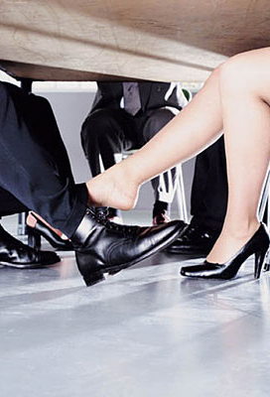
ECONOMIC HARASSMENT
Quid pro quo or economic harassment
Automatic liability
Tangible employment action must actually occur
Notes:
Slide Show Notes
There are two main forms of sexual harassment, which we’ll review in the next slides.
“Economic harassment” is also known as “tangible employment harassment.” It involves quid pro quo, or “this for that” – essentially, it means that the victim is the target of a tangible economic action because he or she refuses a sexual request. Examples might include: Being fired, or being passed over for a promotion or a raise, or being given less desirable work assignments by a person in authority for refusing his or her sexual advances. Alternately, a person might be promised a raise or other job benefit in return for sexual favors. Economic harassment focuses on the harm done to the victim rather than on the specific conduct of the harasser.
The workplace is automatically liable in cases of economic harassment if a supervisor takes tangible economic action against an employee.
However, the workplace is automatically liable only if the threat of a negative action, or the promise of a positive benefit, actually results in an employment action such as termination, promotion, demotion, or reassignment to a considerably different position.

Slide 12
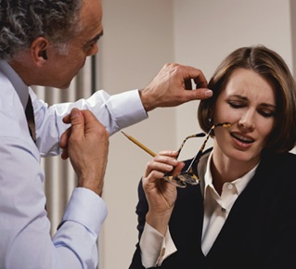
HOSTILE WORK ENVIRONMENT
Severe or pervasive conduct (or both)
Intimidating, hostile, or offensive displays
Notes:
Slide Show Notes
The other main form of sexual harassment is hostile work environment.
Conduct that is either severe or pervasive, or both, constitutes a hostile work environment. In other words, the offensive conduct might be aimed specifically at certain persons, or it might be more generalized throughout the workplace.
This kind of regular and repeated conduct can include items displayed in the workplace that unreasonably interfere with job performance or that create an intimidating, hostile, or offensive work environment.
﻿Suggest that a simple test for determining when something goes over the line might be, “Would I want my spouse, child, or parent to have to experience, see, or listen to something like this?”

Slide 13

HOSTILE WORK ENVIRONMENT (cont.)
Examples include:
Sexually explicit pictures, calendars, graffiti, or objects
Regularly:
Using dirty words
Making sexual jokes
Using obscene gestures
Making rude comments of a sexual nature
Notes:
Slide Show Notes
Examples of a hostile work environment include:
Posting sexually explicit pictures, calendars, graffiti, or objects around the work area, and
Regularly using dirty words, making sexual jokes, using obscene gestures, or making rude comments of a sexual nature.

Slide 14
ECONOMIC HARASSMENT OR HOSTILE WORK ENVIRONMENT?
An employee is asked to talk about her raise with her supervisor after business hours at a romantic restaurant.
An employee brings a sexually explicit gag gift into work for a co-worker’s birthday present.
This is economic harassment.
This describes a hostile work environment.
Notes:
Slide Show Notes
In this exercise, decide whether the following statements are describing economic harassment or hostile work environment:
An employee is asked to talk about her raise with her supervisor after business hours at a romantic restaurant.
This is economic harassment.
An employee brings a sexually explicit gag gift into work for a co-worker’s birthday present.
This describes a hostile work environment.

Slide 15
Economic Harassment or Hostile Work Environment? (cont.)
A supervisor regularly uses obscene language when talking to his employees.
An employee who appears to be “very close” to the boss always gets the easiest job assignments.
This describes a hostile work environment.
This is economic harassment.
Notes:
Slide Show Notes
Here are two more examples. Decide whether they are describing economic harassment or hostile work environment:
A supervisor regularly uses obscene language when talking to his employees.
This also describes a hostile work environment.
An employee who appears to be “very close” to the boss always gets the easiest job assignments.
This is economic harassment.

Slide 16



WHO IS AFFECTED?
Those who commit acts of sexual harassment, including:
Employees at any level
Clients or customers
Members of the same sex
Notes:
Slide Show Notes
It’s important to understand who is affected by sexual harassment laws and workplace policies when it occurs in the workplace.
Those who commit acts of sexual harassment can be anyone in the organization, at any level. In other words, unlawful sexual harassment can travel up, down, and sideways within the organization.
Similarly, clients and customers can also be guilty of committing sexual harassment against employees.
Finally, harassers and victims can be members of the same sex. There can be male-on-male or female-on-female acts of sexual harassment. As mentioned earlier, the key is not the sexual orientation of the person or persons involved, but rather that the act of harassment is sexual in nature. Ordinary socializing in the workplace that may include horseplay or even flirtation between members of the same sex will generally NOT be considered harassment; instead, the harassment must be of a severely hostile or abusive nature.

Slide 17

WHO IS AFFECTED? (cont.)
Those who experience harassment, including:
Direct targets
Bystanders and witnesses
Notes:
Slide Show Notes
Sexual harassment laws and policies also affect those who experience the harassment. These include:
Direct targets of sexual harassment—for example, someone who is constantly subjected to a co-worker’s sexual advances is a direct target of sexual harassment and, therefore, a victim of an unlawful act.
Bystanders and witnesses may also be considered to be sexual harassment victims, depending on the specifics of the case. In other words, if you witness acts of sexual harassment against a co-worker, you may also be affected by harassment and may be protected under the law.

Slide 18

SEXUAL HARASSMENT
Do you understand the two main forms of sexual harassment – economic harassment and hostile work environment?
Is it clear who may be affected by sexual harassment in the workplace?
Notes:
Slide Show Notes
Now it is time to ask yourself if you understand the information presented so far. Do you understand the two main forms of sexual harassment—economic harassment and a hostile work environment? Is it clear who may be affected by sexual harassment in the workplace?

Slide 19
PREVENTION: What We Can All Do To Help
Provide a clear statement of our position against sexual harassment
Promote compliance and prevention by defining responsibilities
Protect your rights and foster respect for everyone
Notes:
Slide Show Notes
Now let’s talk about prevention —what we all can do to prevent sexual harassment. Both the workplace and you, as an employee, have responsibilities.
As a workplace, we work to create, communicate, and enforce a policy on sexual harassment that accomplishes the following goals:
First, it provides a clear statement of our position against sexual harassment, so that everyone understands what is and what is not acceptable behavior.
Second, it promotes compliance, as well as prevention, by defining the responsibilities of managers and employees in preventing sexual harassment and in responding quickly and thoroughly to any complaints.
Finally, it protects your rights and fosters respect for everyone. We want to maintain a respectful and dignified work environment by preserving confidentiality whenever possible, and by communicating and enforcing a policy of “no retaliation” against anyone who reports sexual harassment.
Introduce and review your workplace’s sexual harassment policy.

Slide 20

PREVENTION: What You Can Do
Know and comply with company policy
Address incidents of sexual harassment immediately
Notes:
Slide Show Notes
Here are some of the things you can do to help prevent sexual harassment:
First, know and comply with workplace policy on sexual harassment. Be sure to take the time to read it, and ask your supervisor or HR representative if you have any questions about your responsibilities.
Next, and more specifically, it’s very important to address incidents of sexual harassment immediately. Report any incident that you reasonably believe is offensive, whether you are the direct target or not. If you can, respond directly to anyone who is committing sexual harassment, making it clear that this behavior bothers you. If it’s uncomfortable for you to address them directly – for example, if the harasser is your supervisor –report the incident to your supervisor’s manager or to an HR representative. Record the time, place, and details of the incident, including the names of any co-workers who might have observed it.
Explain your workplace’s procedures for reporting incidents of sexual harassment. Make sure trainees know specifically who they can go to with a complaint. Assure trainees that complaints will be handled promptly, sensitively, and as confidentially as possible

Slide 21

PREVENTION: What You Can Do to Help (cont.)
Support victims
Cooperate with investigations
Notes:
Slide Show Notes
In addition, you can help prevent sexual harassment by supporting victims of sexual harassment as much as possible. Encourage them to report incidents according to workplace policy, and support them throughout the process until it is resolved to everyone’s satisfaction.
Finally, cooperate with investigations of sexual harassment. Provide any information you might have about an incident, and do your part to help make the investigation run smoothly and move as quickly as possible toward a resolution.

Slide 22

Sexual harassment is prohibited by law and workplace policy
It involves more than physical conduct; it can also be verbal or visual
Sexual harassment harms us all
You have the power to help prevent it
Notes:
Slide Show Notes
In conclusion, here are the key points you should remember from this training session on sexual harassment:
Sexual harassment is prohibited, both by law and by workplace policy;
Sexual harassment involves more than just physical conduct; it can also be verbal or visual;
Sexual harassment harms us all because it takes away from having a respectful, dignified, and comfortable work environment; and
Finally, you have the power to help prevent sexual harassment. Know the workplace’s policy, and do your part to confront sexual harassment, report incidents, and support victims.
This concludes this training session.
Give the quiz, if appropriate.

